Slide 1
School - system
Caio Augusto de Azevedo pereira

Slide 2
Task I
We would like the candidate to build a student and course management and registration system using MVC. The system should allow users to add, update and delete students and course. The system should also display a paged list of students in the system and be searchable. Also, the system should allow user to register course for each student.
The data should be read from a database and the students should have the following characteristics: First Name, Surname, Gender, DOB, Address 1, Address 2, Address 3.
The courses should have the following characteristics: Course Code, Course Name, Teacher Name, Start Date, End Date
Please note: One student could choose max 5 different courses, and there are limit spaces in each course. One student couldn’t register same course twice, also, one course couldn’t have same student twice.

Slide 3
Task Ii
Add a form authentication for above project. Two types of user are required: Admin & Student. For Student, only allow to update own details, and register course for student self. For Admin, it’s able to manage all student record and course record, also it’s able to register course for any student.

Slide 4
Task Iii
Create the below SQL reports for above project. Those reports could be built with SQL View or SQL Stored Procedure.
1. Show registered courses for each student
2. Show student list for each courses
3. Show how many students didn’t register max course
4. Show how many courses still have the space

Slide 5
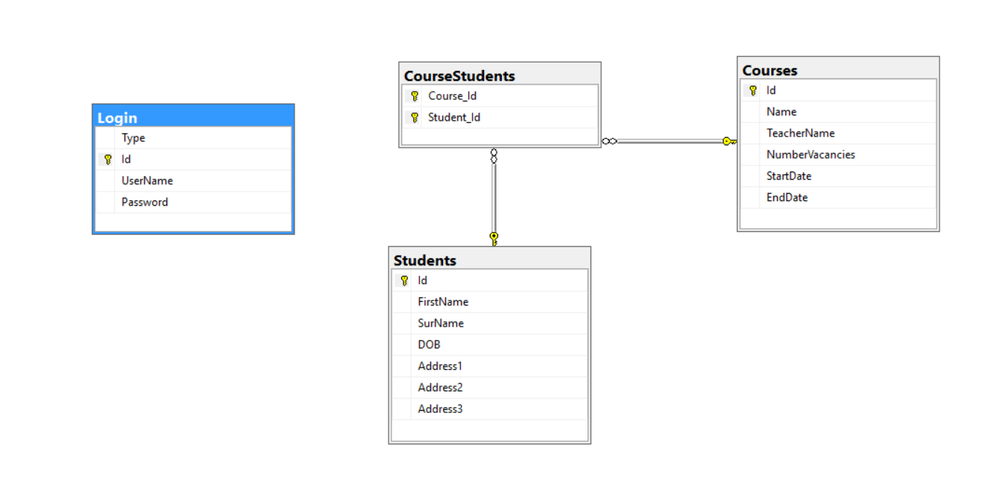
Database diagram

Slide 6
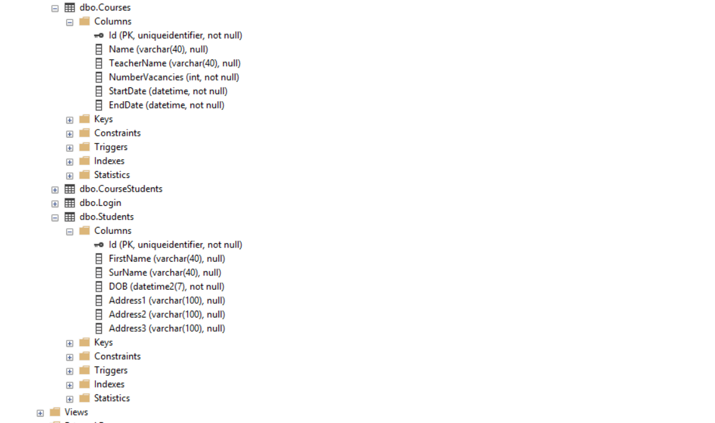
Details tables
I'm using uniqueidenfier with PK it because I take responsibility for my database from saving the ID and it generates all by the application.
Why do you using GUID?
In Addition to Security the GUID’s 128-bits is big enough and the generation algorithm is unique enough that if 1,000,000,000 GUIDs per second were generated for 1 year the probability of a duplicate would be only 50%. Or if every human on Earth generated 600,000,000 GUIDs there would only be a 50% probability of a duplicate.

Slide 7
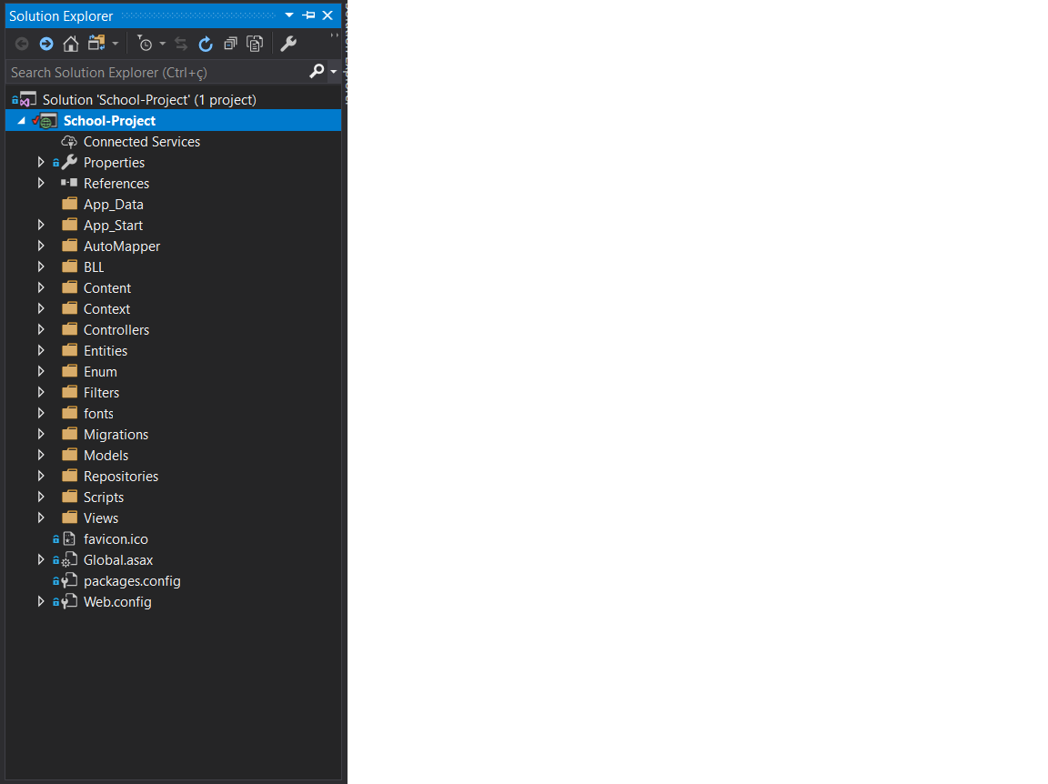
Solution explore
BLL (Business Logic Layer) is system business rules
Controller (The Controller in MVC architecture handles any incoming URL request)
Entities (Models of database)
Migrations and Context (Configuration of tables database)
Repositories (Consulting in database)

Slide 8
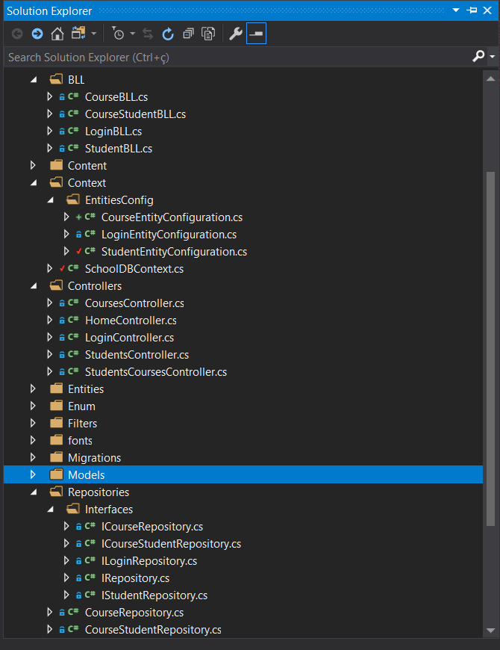
+folder solution
EntitiesConfig (Configuration Column database)
Repositories->Interfaces (Contract of database methods)

Slide 9
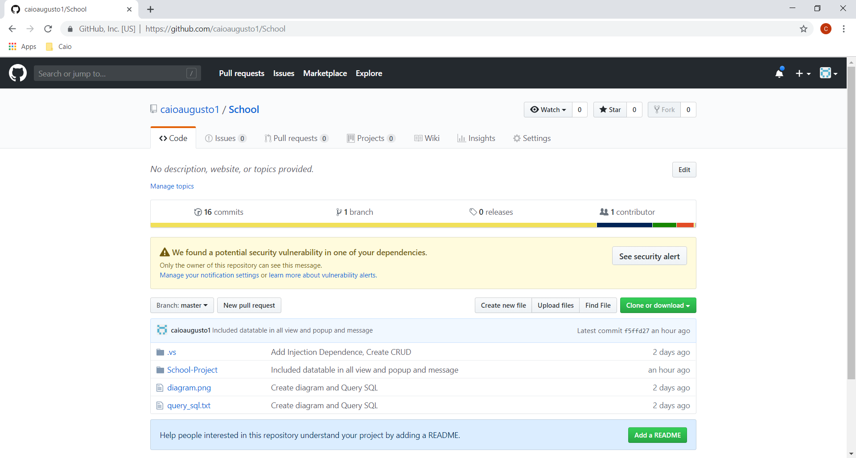
Versioning
GitHub é uma plataforma de hospedagem de código-fonte com controle de versão usando o Git.
It code is avaliable: https://github.com/caioaugusto1/School

Slide 10
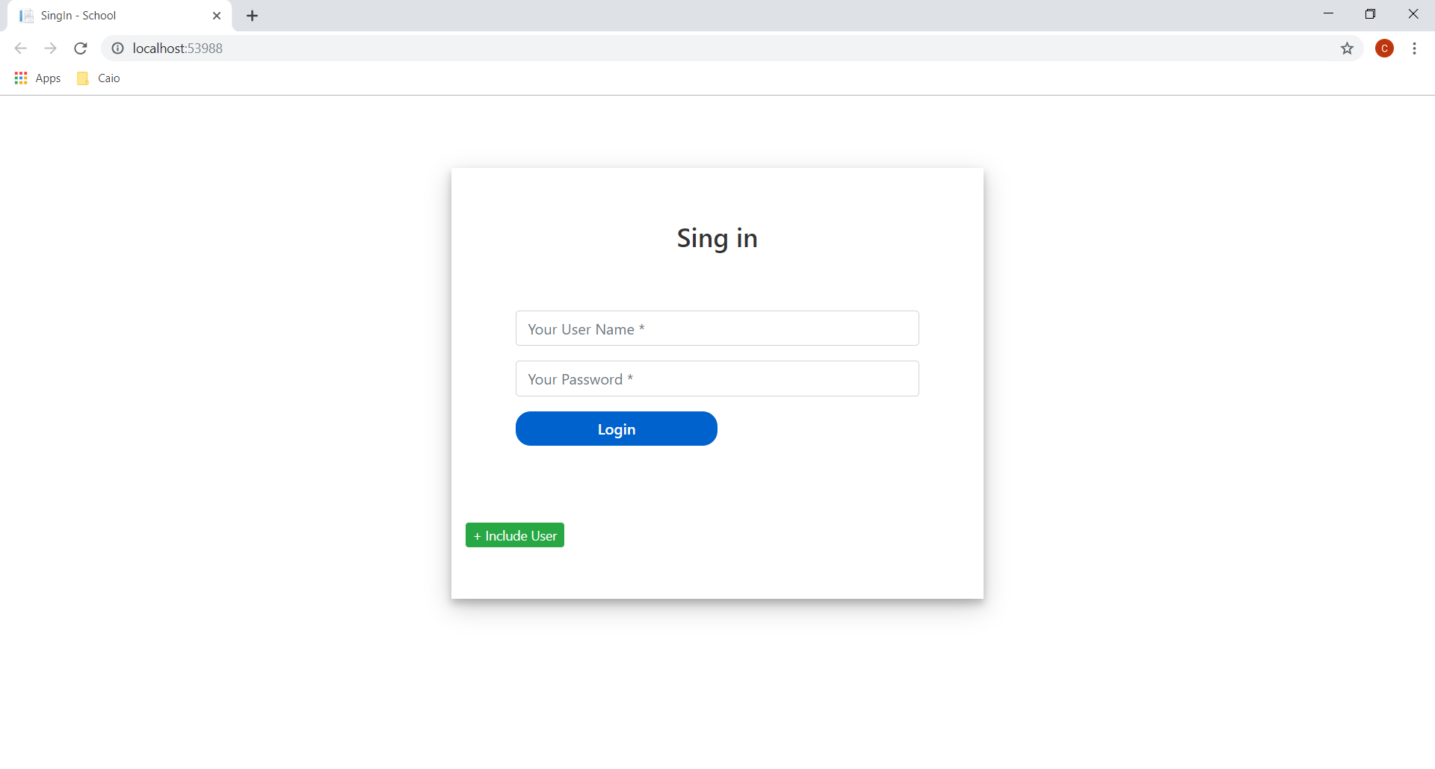
Login view
This view is responsibility to restrict acess
Have button create new user available to test

Slide 11
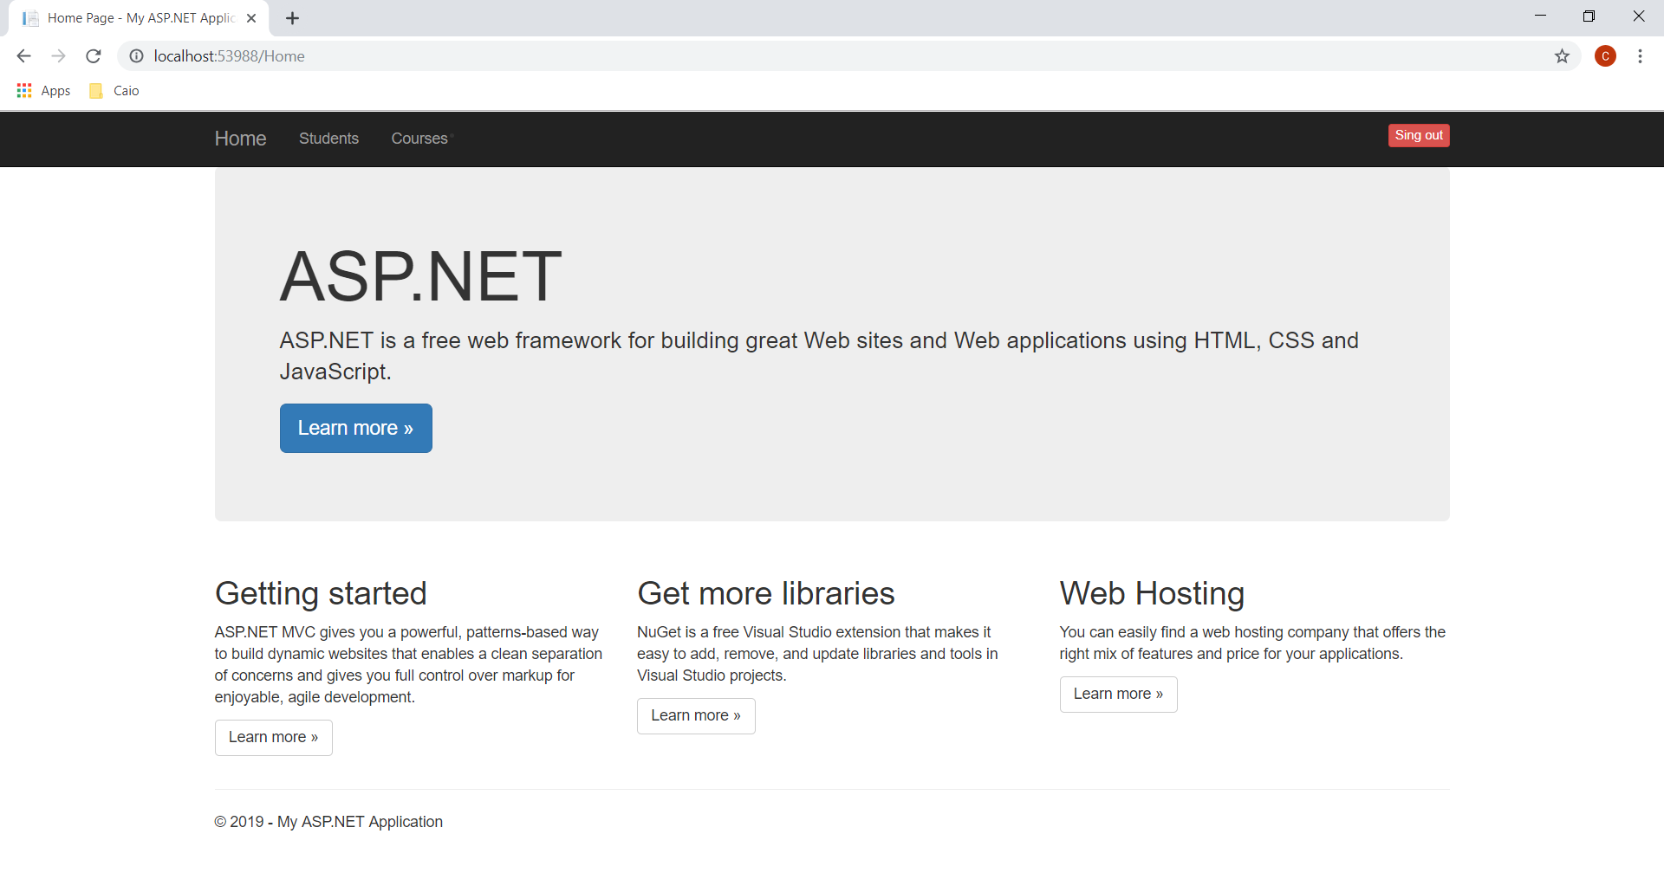
Home view
This is home view
Have five buttons – Home, Students, Courses and Sing out

Slide 12
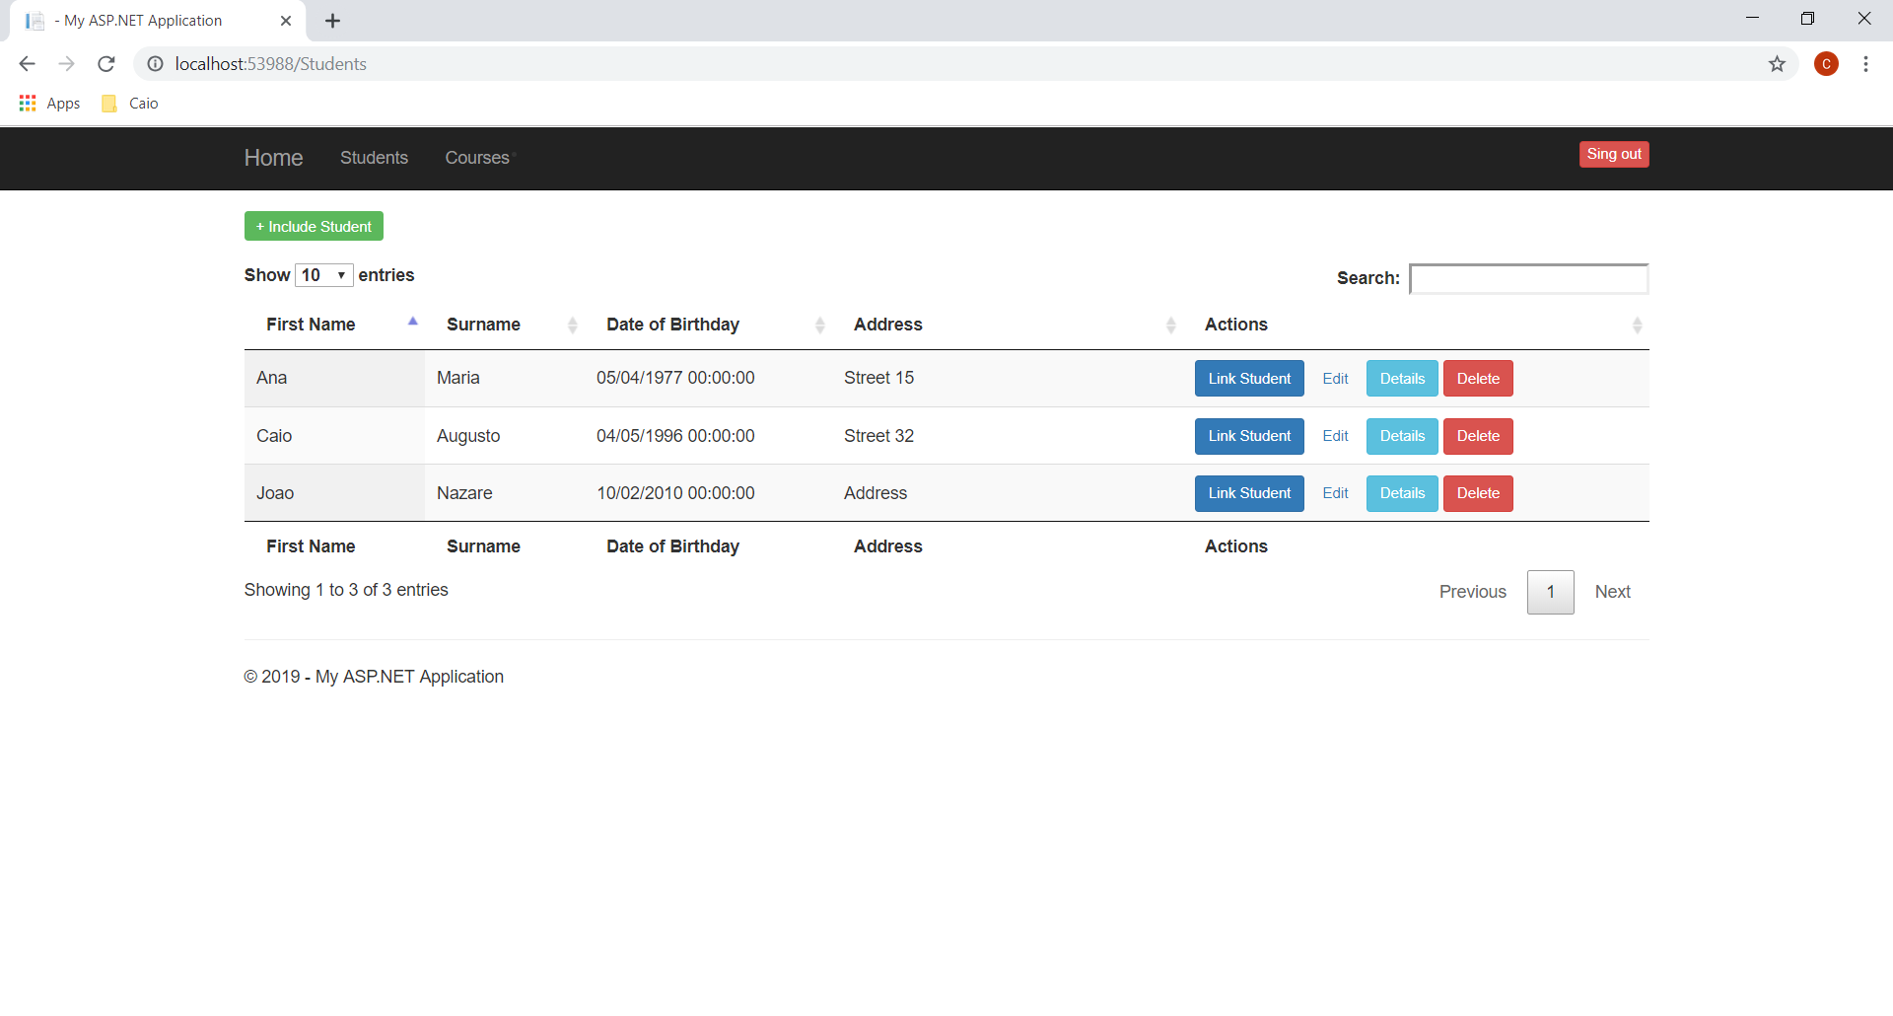
Home students
Students List (Paged list, with some student information)
Button Link Student (It will take us to the screen to link the student to many courses)
Edit (It will take us to the screen to edit student)
Details (It will take us to the screen of view details student)
Delete (It will take us to the screen of delete student)

Slide 13
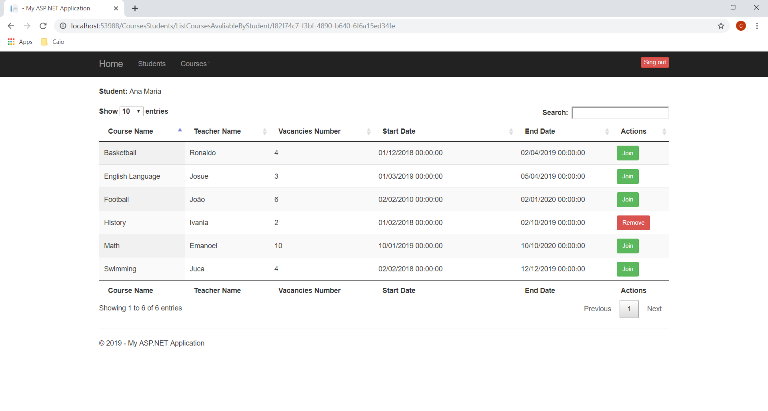
Course list Avaliable to student
Courses List to join student Ana Maria

Slide 14
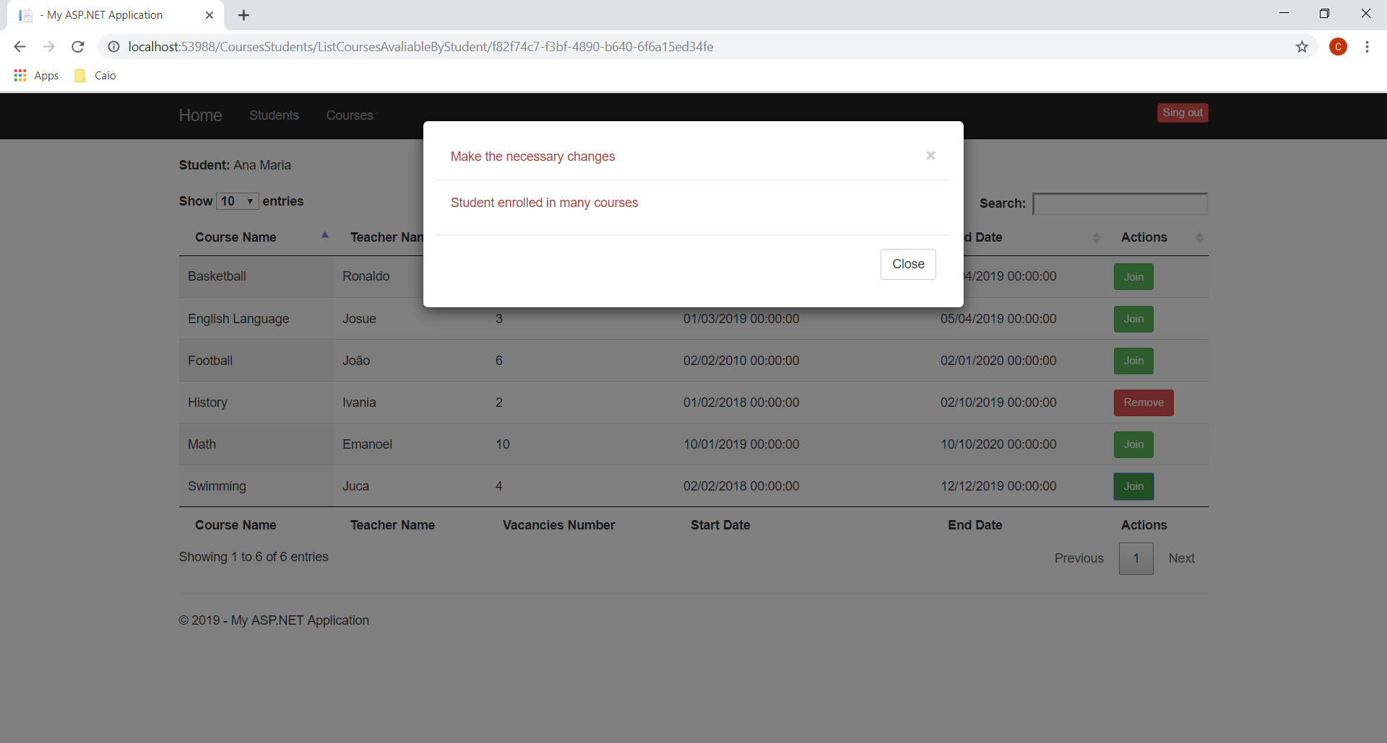
error
In this case I tried to link the student Ana Maria in a course with dates divergent (Swimming and History)

Slide 15
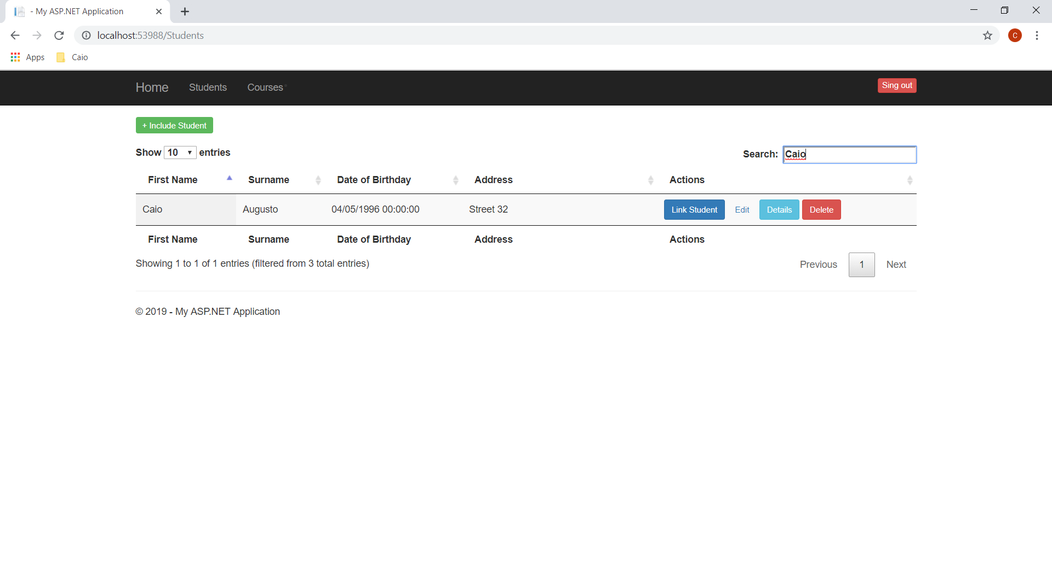
Student Filter
Filter de student any column

Slide 16
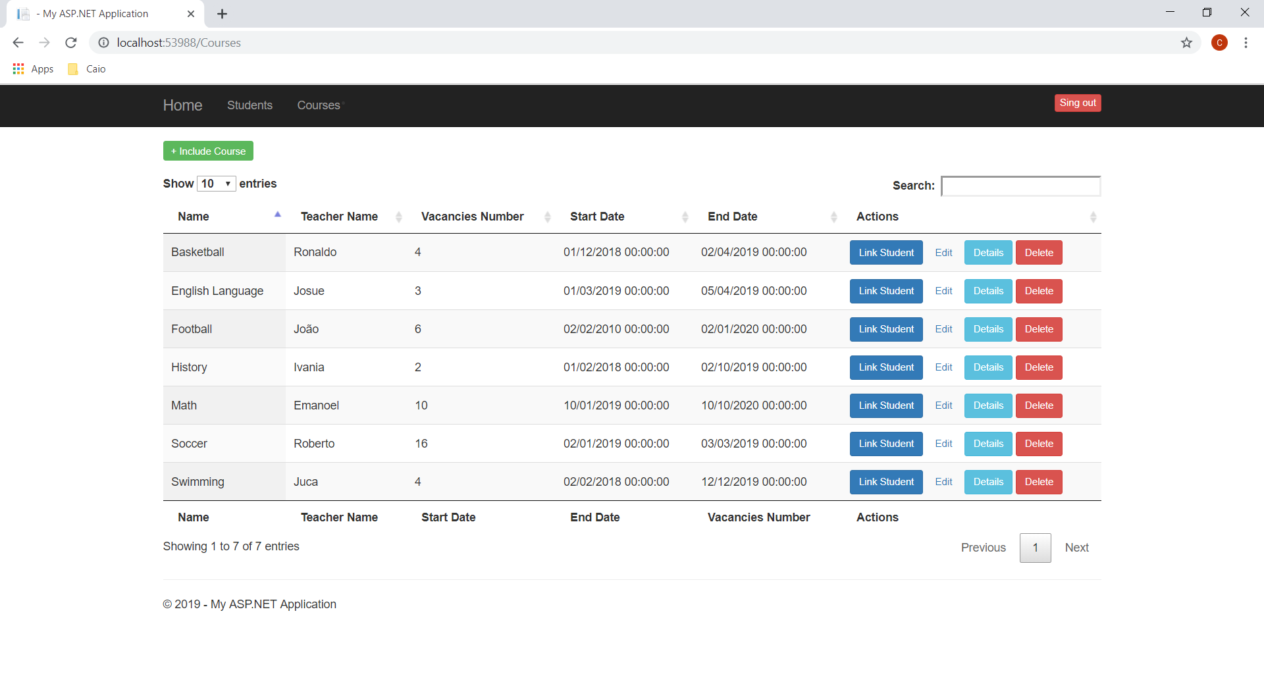
Course list
List of courses with four buttons, possible to link many students to a course, edit courses, details and delete

Slide 17
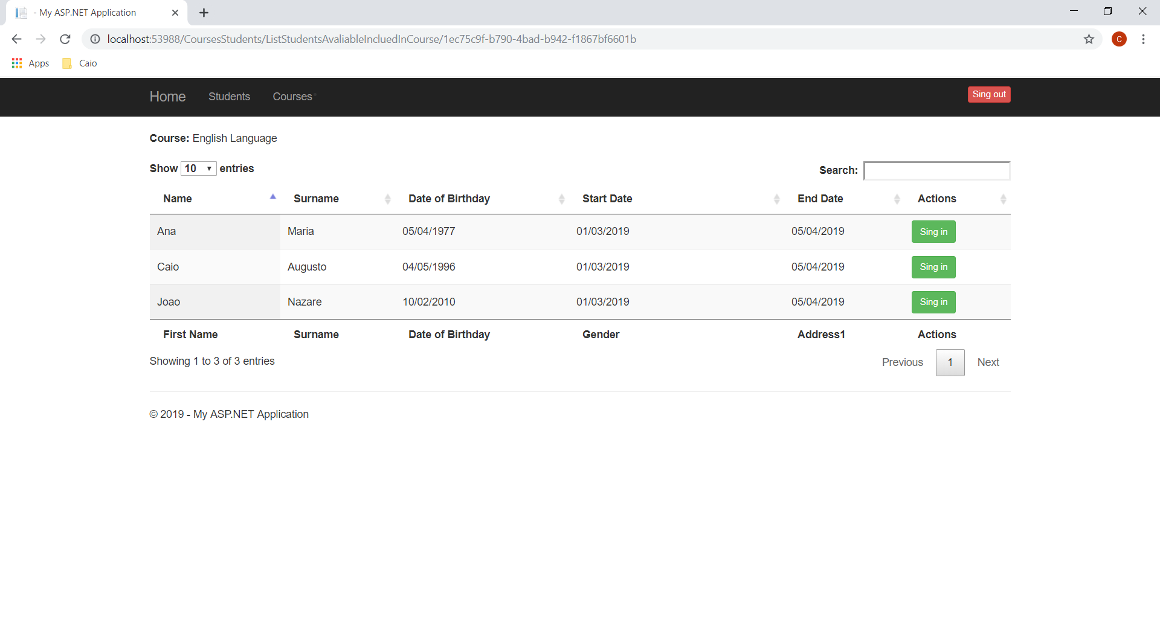
Lint students in course
This screen we have the possibility to link many students to a course

Slide 18
Connection string
Configure connectionString and open your Package-manager Console
1. update-database
https://docs.microsoft.com/en-us/aspnet/mvc/overview/getting-started/getting-started-with-ef-using-mvc/migrations-and-deployment-with-the-entity-framework-in-an-asp-net-mvc-application
<add name="ContextSchoolDB" connectionString="data source=.\SQLEXPRESS;initial catalog=SchoolDB;integrated security=True;multipleactiveresultsets=True;application name=EntityFramework" providerName="System.Data.SqlClient" />

Slide 19
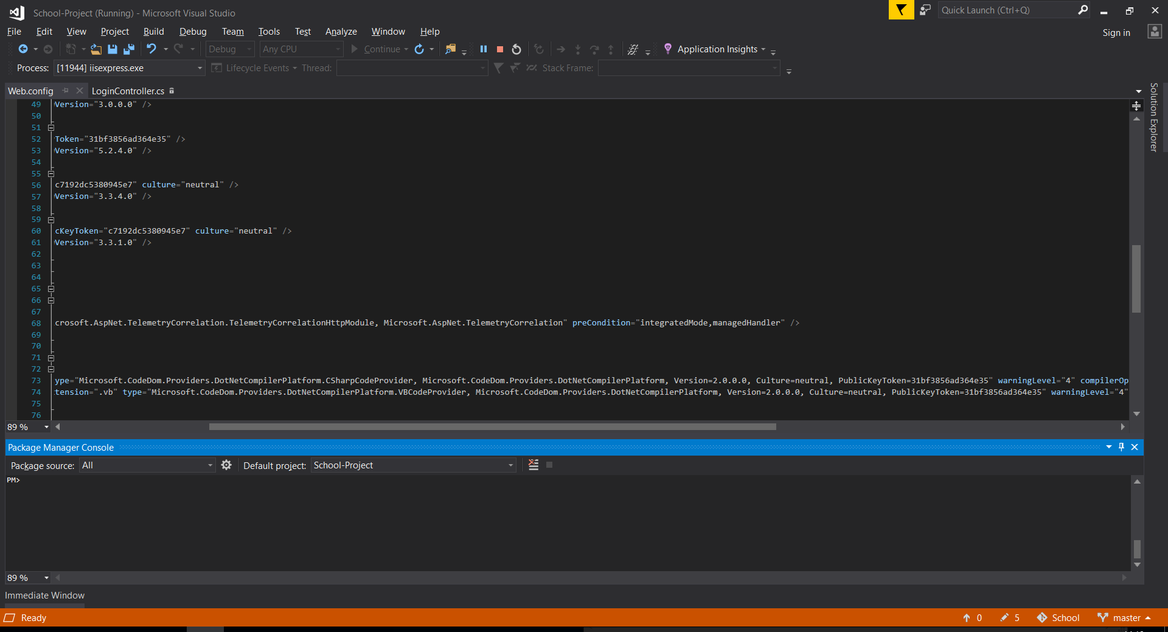
Package manager console

Slide 20
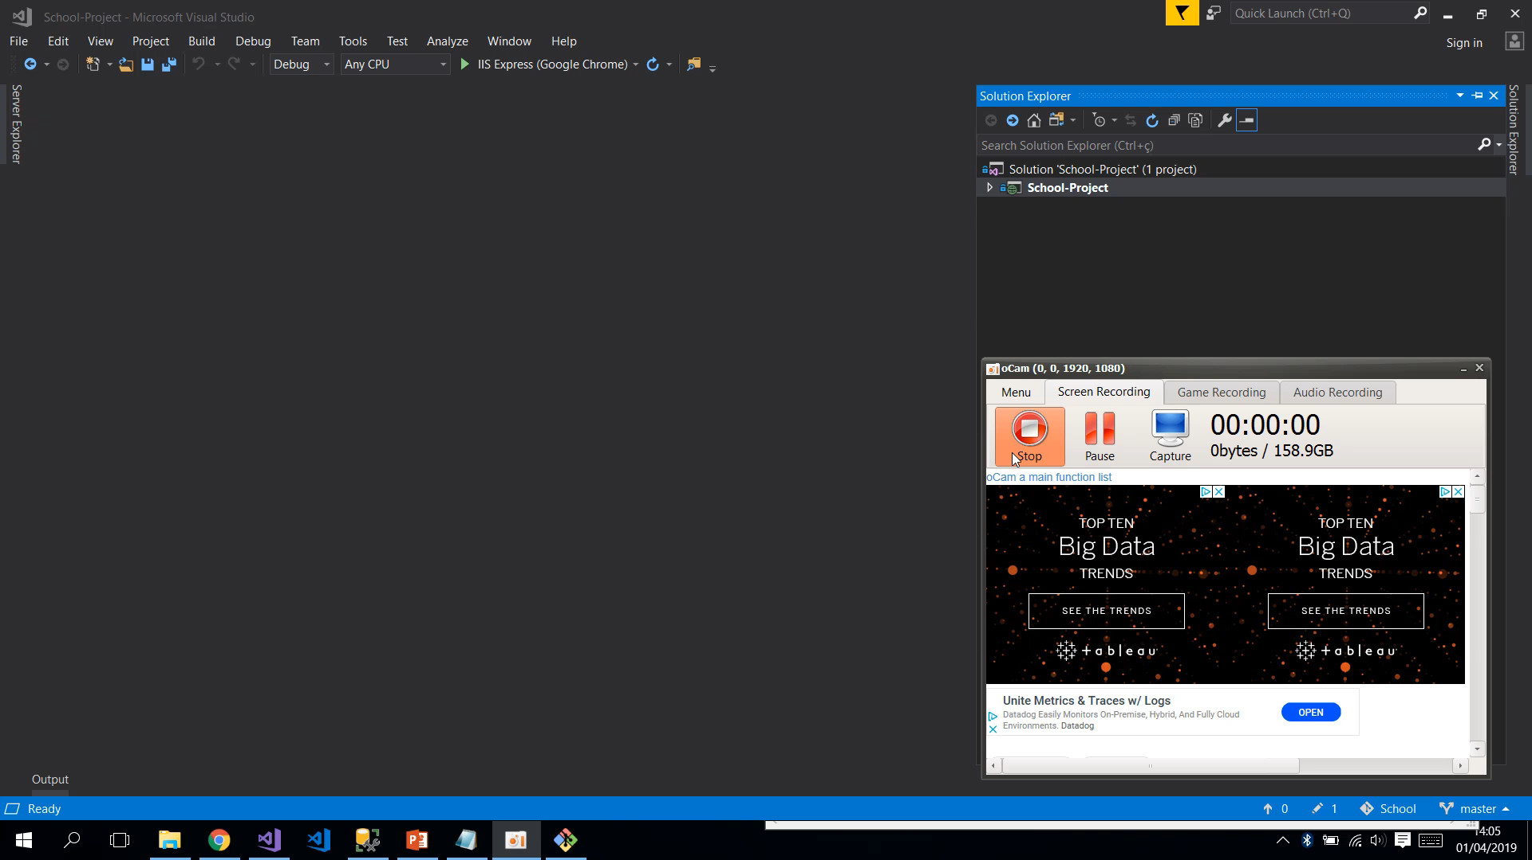

Slide 21
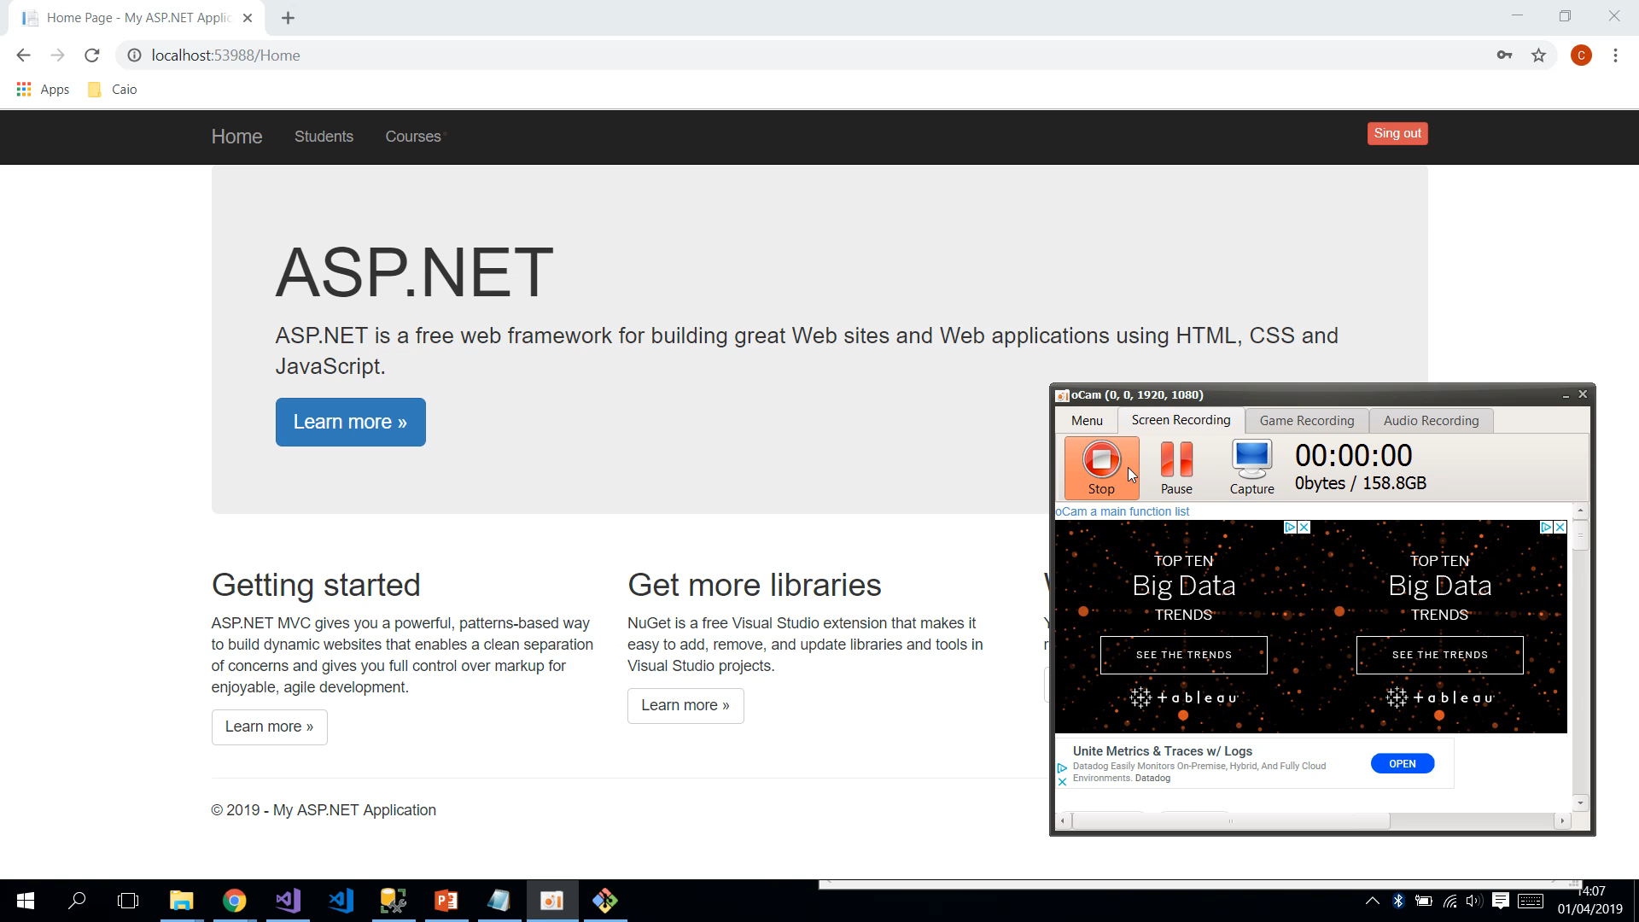

Slide 22



Thanks very much

